Slide 1

HOSPITALITY DOMAIN INSIGHTS

Slide 2
Content
INSIGHTS
Bookings
Revenue
Review
Key Points
Key Points on Bookings
Key Points on Revenue & Review
About
Introduction
Objective
Tools
Tools used

Slide 3

Content
ABOUT
Introduction
Objective
INSIGHTS
Bookings
Revenue
Review
Key Points
Key Points on Bookings
Key Points on Revenue & Review
Tools
Tools used

Slide 4
ABOUT

Slide 5
AtliQ Grands, a leading figure in the hospitality sector, boasts a rich two-decade history overseeing numerous five-star hotels throughout India.
Introduction

Slide 6

AtliQ Grands aimed to reintegrate "Business and Data Intelligence" to recover their market share and boost revenue. They sought to leverage data analytics to gain valuable insights that would contribute to this objective.
Objective

Slide 7
INSIGHTS

Slide 8
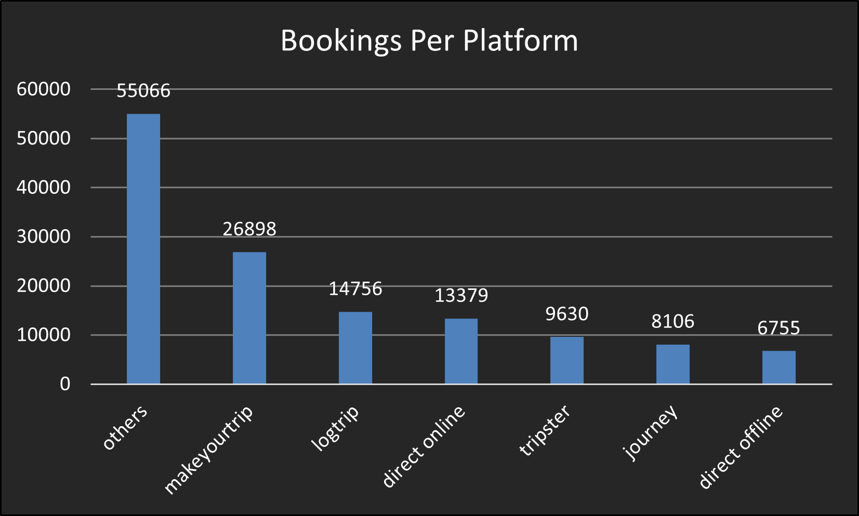
Bookings
Total Bookings per platforms.

Slide 9
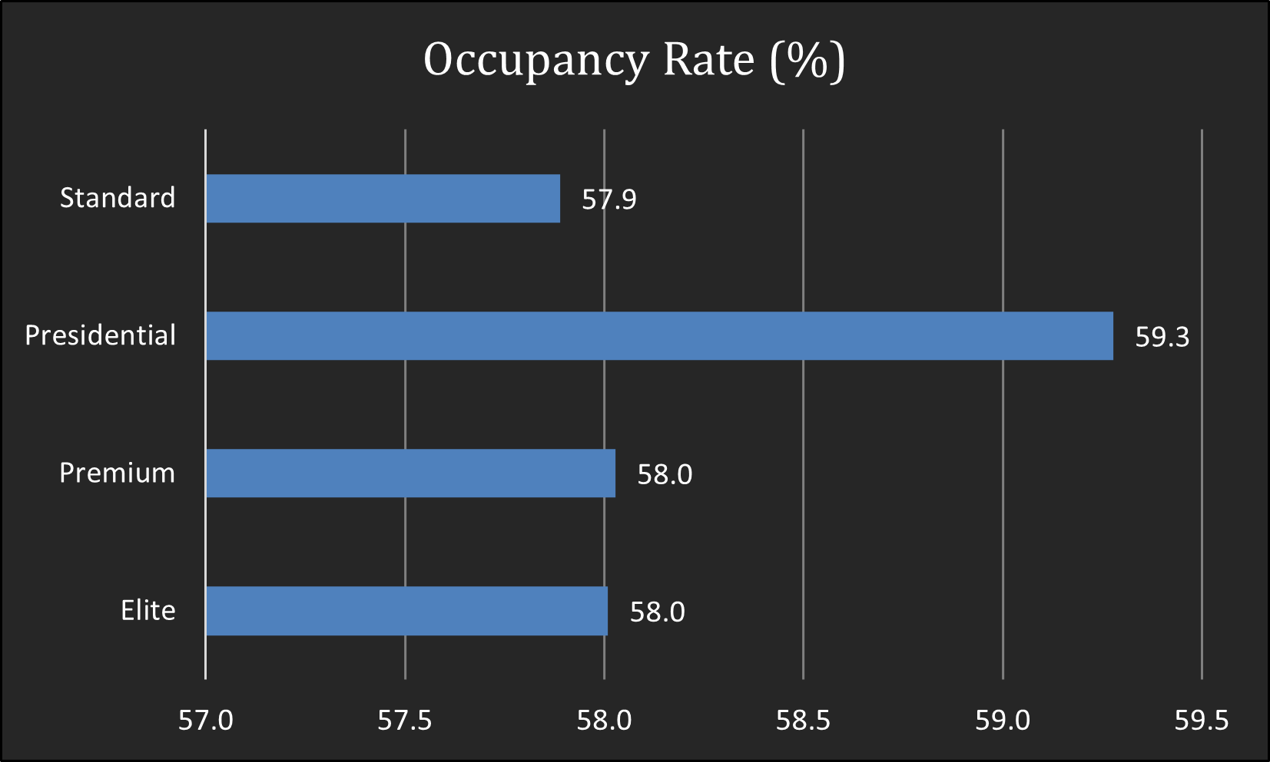
Bookings
What is an average occupancy rate in each of the room categories?

Slide 10
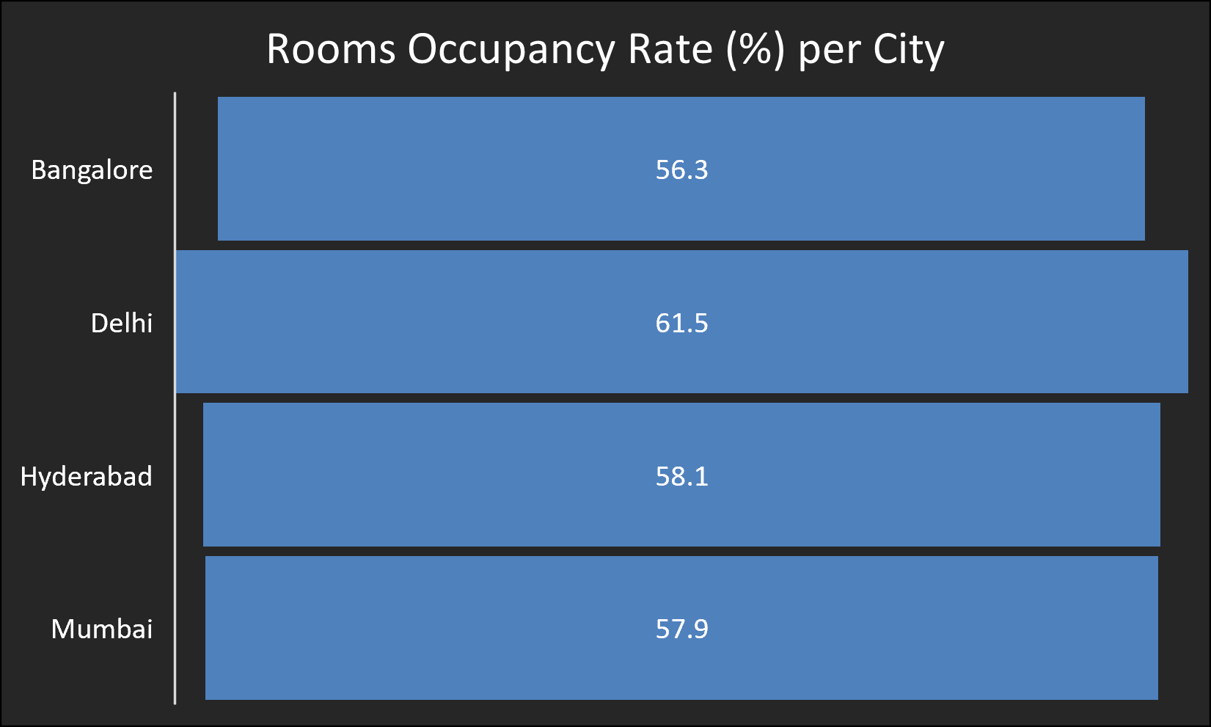
Bookings
Average occupancy rate per city.

Slide 11
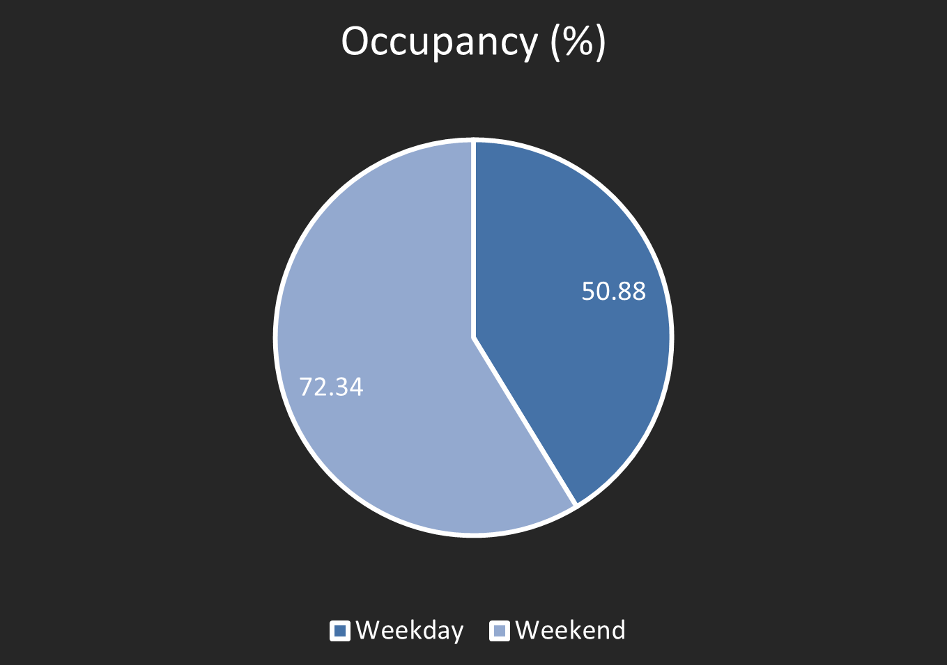
When was the occupancy better?
Bookings

Slide 12
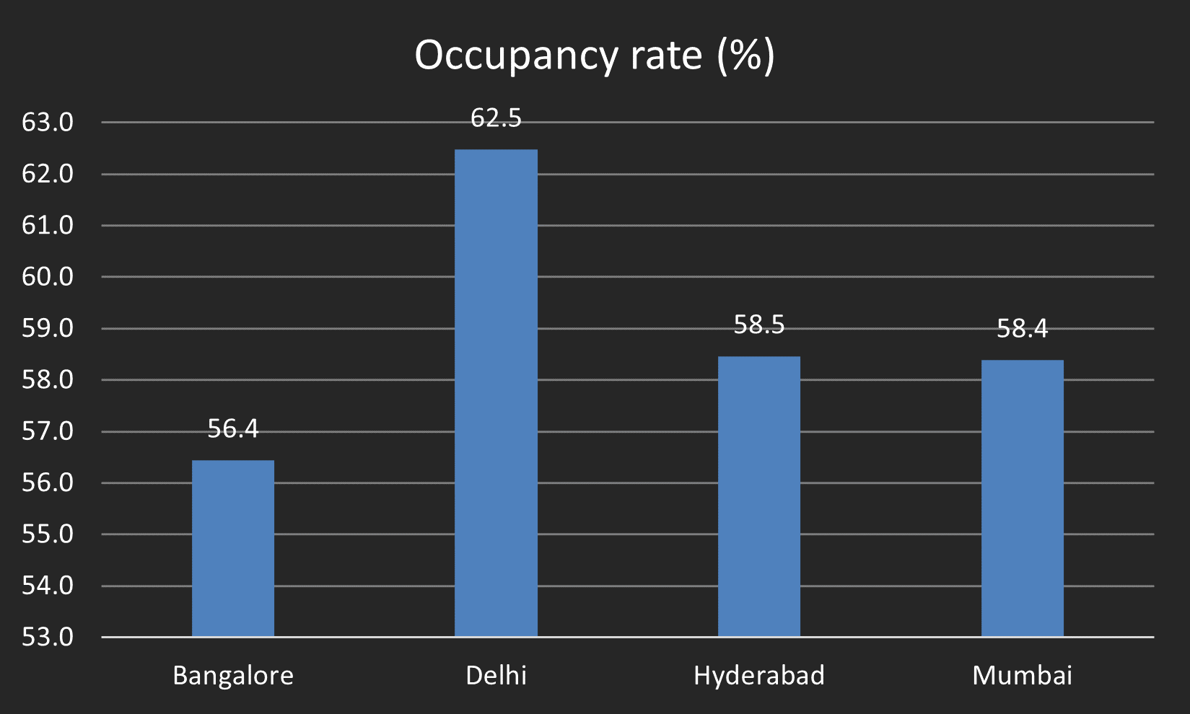
In the month of June, what is the occupancy for different cities ?
Bookings

Slide 13
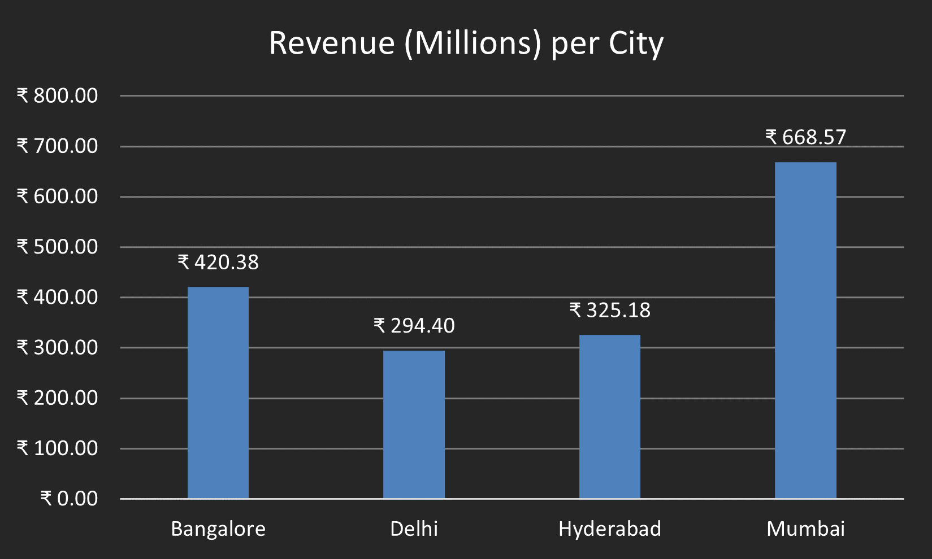
Revenue realized per city
Revenue

Slide 14
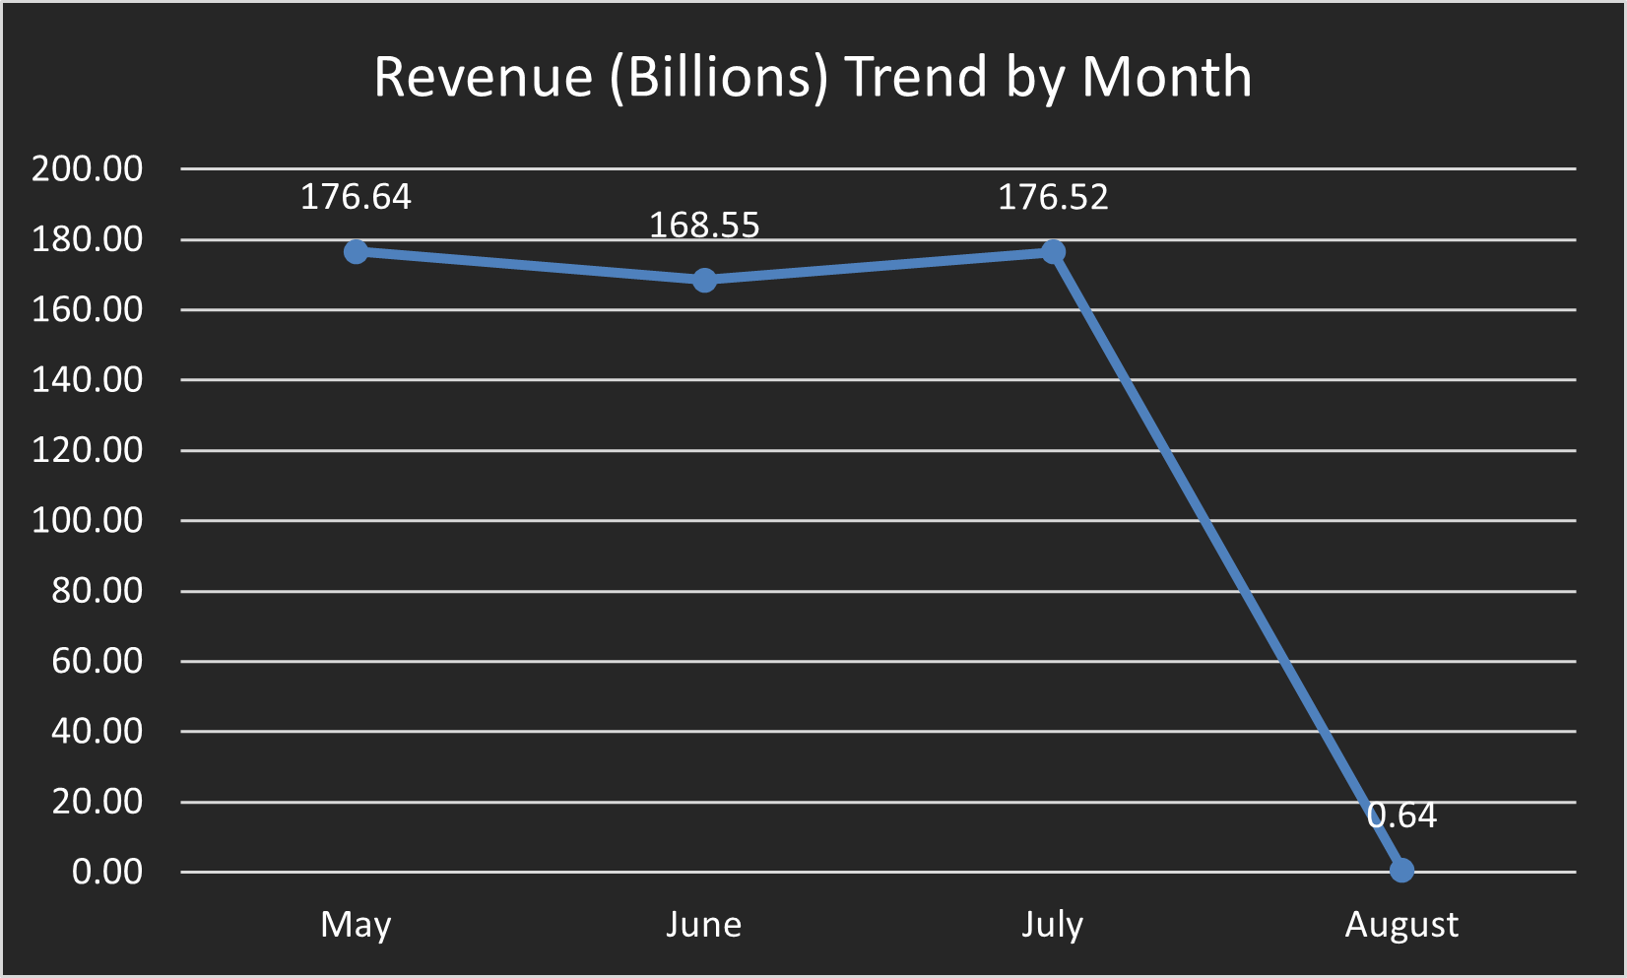
Revenue month by month.
Revenue

Slide 15
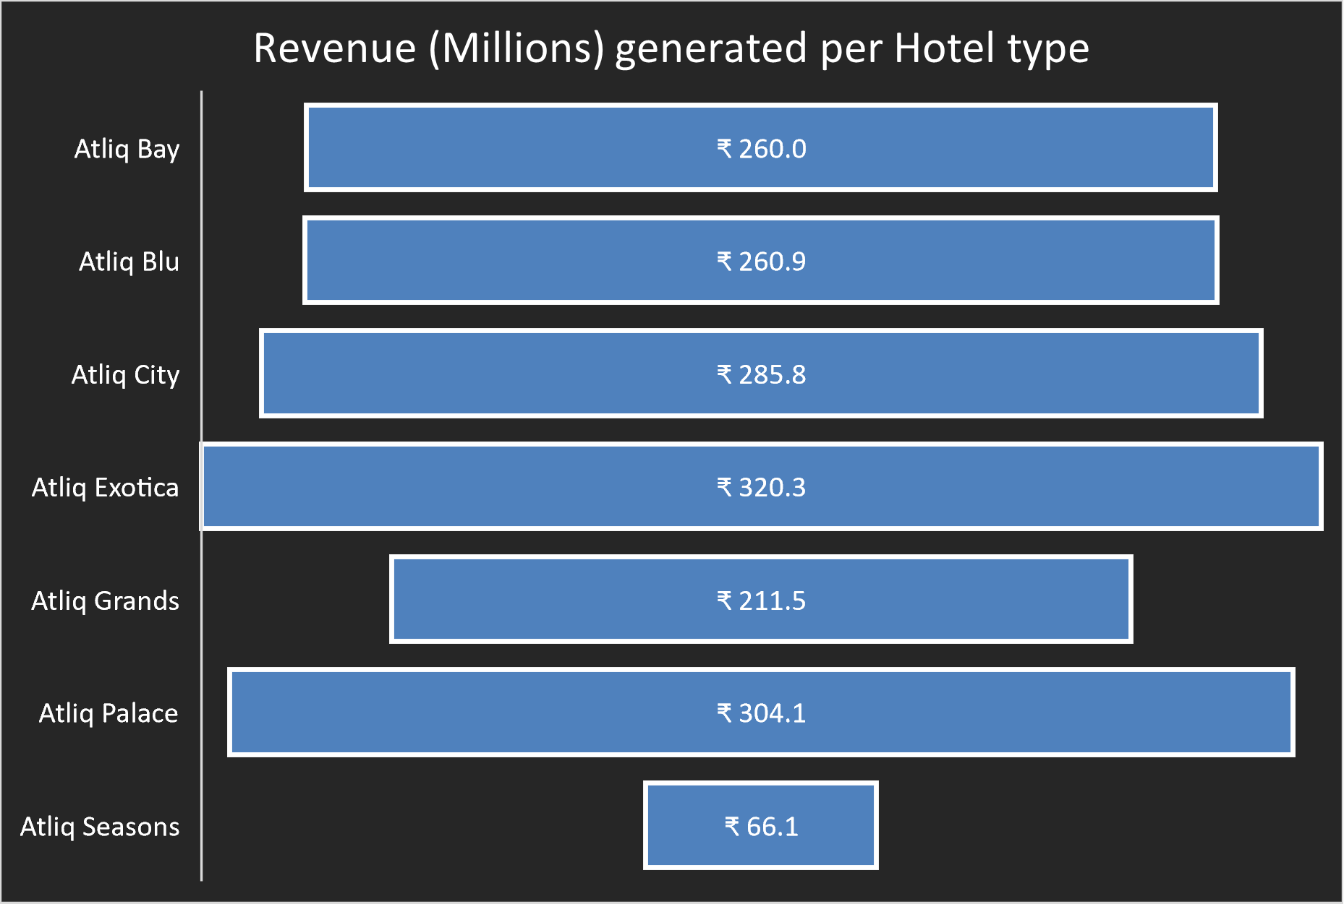
Revenue realized per hotel type.
Revenue

Slide 16
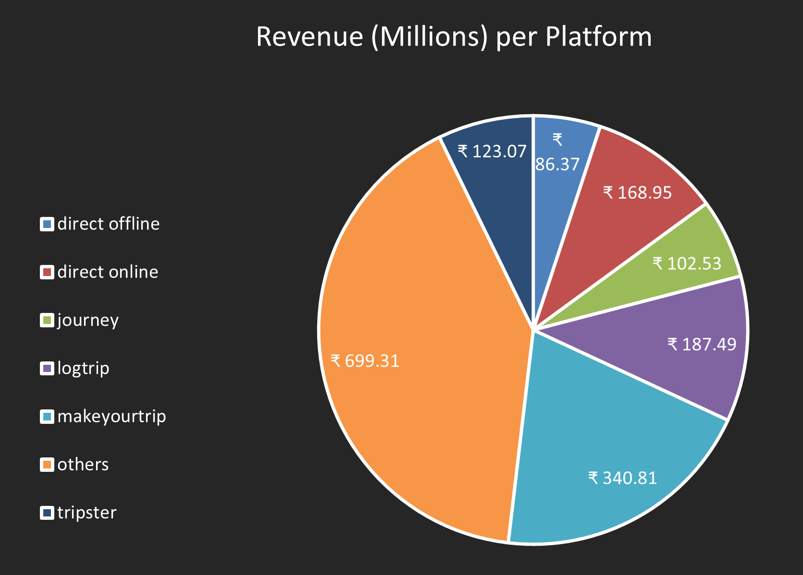
Revenue realized per booking platform
Revenue

Slide 17
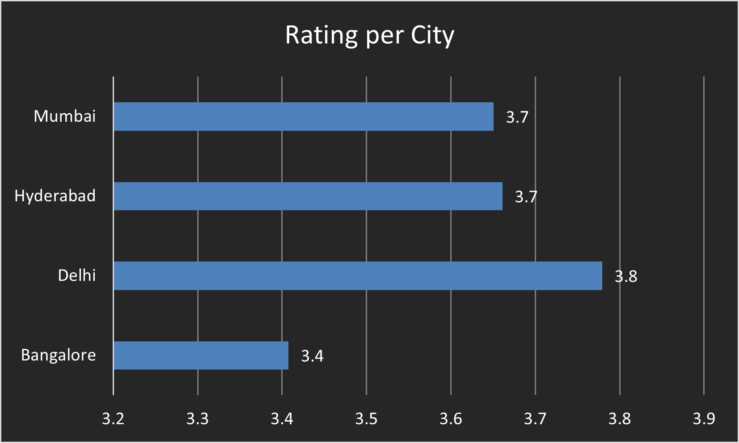
Average rating per city
Review

Slide 18
Key Points

Slide 19
Bookings
Presidential room have the maximum occupancy rate out of all the room categories.
Top three platforms at bookings:
Others
Makeyourtrip
Logtrip
Key Points
Weekends are performing better than weekdays with a difference of 12.54 % in occupancy rate.
Delhi with 61.5 % has the highest room occupancy rate among the all cities.
In the month of June, Delhi with 62.5 % has the highest room occupancy rate among the all cities.

Slide 20
Bookings
Top three platforms at bookings:
Others
Makeyourtrip
Logtrip
Weekends are performing better than weekdays with a difference of 12.54 % in occupancy rate.
Presidential room have the maximum occupancy rate out of all the room categories.
Delhi with 61.5 % has the highest room occupancy rate among the all cities.
In the month of June, Delhi with 62.5 % has the highest room occupancy rate among the all cities.

Slide 21
Bookings
Presidential room have the maximum occupancy rate out of all the room categories.
Top three platforms at bookings:
Others
Makeyourtrip
Logtrip
Weekends are performing better than weekdays with a difference of 12.54 % in occupancy rate.
Delhi with 61.5 % has the highest room occupancy rate among the all cities.
In the month of June, Delhi with 62.5 % has the highest room occupancy rate among the all cities.

Slide 22
Bookings
Delhi with 61.5 % has the highest room occupancy rate among the all cities.
Presidential room have the maximum occupancy rate out of all the room categories.
Top three platforms at bookings:
Others
Makeyourtrip
Logtrip
Weekends are performing better than weekdays with a difference of 12.54 % in occupancy rate.
In the month of June, Delhi with 62.5 % has the highest room occupancy rate among the all cities.

Slide 23
Bookings
Delhi with 61.5 % has the highest room occupancy rate among the all cities.
Presidential room have the maximum occupancy rate out of all the room categories.
Top three platforms at bookings:
Others
Makeyourtrip
Logtrip
Weekends are performing better than weekdays with a difference of 12.54 % in occupancy rate.
In the month of June, Delhi with 62.5 % has the highest room occupancy rate among the all cities.

Slide 24
Bookings
Delhi with 61.5 % has the highest room occupancy rate among the all cities.
Presidential room have the maximum occupancy rate out of all the room categories.
Top three platforms at bookings:
Others
Makeyourtrip
Logtrip
Weekends are performing better than weekdays with a difference of 12.54 % in occupancy rate.
In the month of June, Delhi with 62.5 % has the highest room occupancy rate among the all cities.

Slide 25
Revenue & Review
Delhi secures the highest rating with 3.8 among all cities, whereas Bangalore holds the lowest rating with 3.4 .
Others platforms having the highest revenue generation, whereas direct offline methods, has the lowest revenue generation.
Atliq Exotica stands out as the hotel type with the highest revenue generation,
while Atliq Seasons, exhibits the lowest revenue generation.
Among all the cities Mumbai has the highest revenue generation.
Whereas, Delhi has the lowest revenue generation.
Key Points

Slide 26
Revenue & Review
Delhi secures the highest rating with 3.8 among all cities, whereas Bangalore holds the lowest rating with 3.4 .
Others platforms having the highest revenue generation, whereas direct offline methods, has the lowest revenue generation.
Atliq Exotica stands out as the hotel type with the highest revenue generation,
while Atliq Seasons, exhibits the lowest revenue generation.
Among all the cities Mumbai has the highest revenue generation.
Whereas, Delhi has the lowest revenue generation.

Slide 27
Revenue & Review
Delhi secures the highest rating with 3.8 among all cities, whereas Bangalore holds the lowest rating with 3.4 .
Others platforms having the highest revenue generation, whereas direct offline methods, has the lowest revenue generation.
Atliq Exotica stands out as the hotel type with the highest revenue generation,
while Atliq Seasons, exhibits the lowest revenue generation.
Among all the cities Mumbai has the highest revenue generation.
Whereas, Delhi has the lowest revenue generation.

Slide 28
Revenue & Review
Atliq Exotica stands out as the hotel type with the highest revenue generation,
while Atliq Seasons, exhibits the lowest revenue generation.
Delhi secures the highest rating with 3.8 among all cities, whereas Bangalore holds the lowest rating with 3.4 .
Others platforms having the highest revenue generation, whereas direct offline methods, has the lowest revenue generation.
Among all the cities Mumbai has the highest revenue generation.
Whereas, Delhi has the lowest revenue generation.

Slide 29
Revenue & Review
Atliq Exotica stands out as the hotel type with the highest revenue generation,
while Atliq Seasons, exhibits the lowest revenue generation.
Others platforms having the highest revenue generation, whereas direct offline methods, has the lowest revenue generation.
Among all the cities Mumbai has the highest revenue generation.
Whereas, Delhi has the lowest revenue generation.
Delhi secures the highest rating with 3.8 among all cities, whereas Bangalore holds the lowest rating with 3.4 .

Slide 30
Tools

Slide 31


Tools Used
Python
Employed for data exploration, cleaning, transformation, and uncovering insights through pandas, showcasing its multifunctional prowess in diverse data-centric operations.
Excel
It was employed for crafting diverse charts – bar, column, line, funnel, and pie charts – showcasing its versatile visualization capabilities.

Slide 32
THANK YOU

